Slide 1

INL/MIS-22-68146
RAVEN: Overview

Slide 2
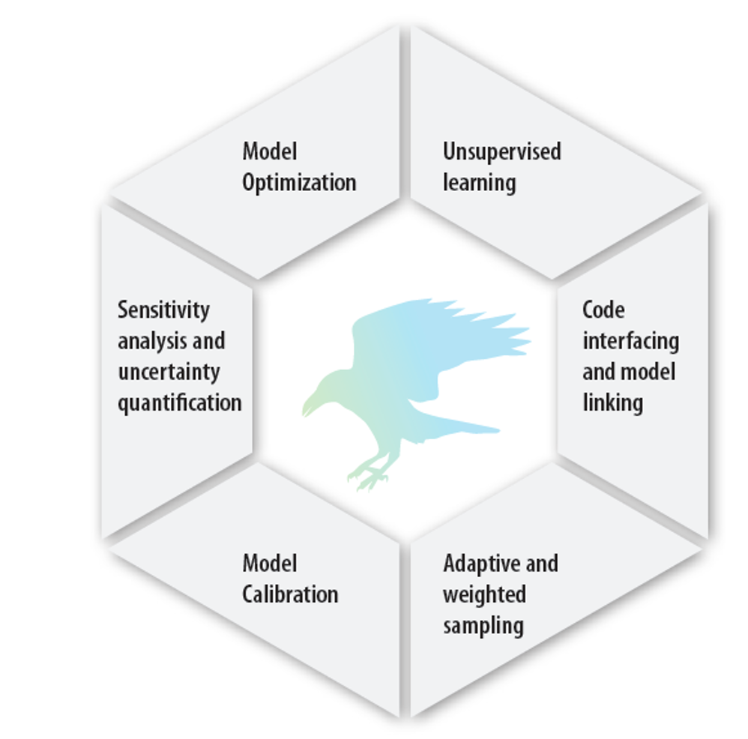
10,000-ft Overview
RAVEN: multi-purpose stochastic platform
Methods/capabilities
Uncertainty propagation
Machine learning
Optimization
Data analysis
Language: designed for applying these methods and capabilities to user-provided simulation models
Development began in early 2012, supported by:
Light Water Reactor Sustainability (LWRS) program
Nuclear Energy Advanced Modeling and Simulation Program (NEAMS)
Nuclear-Renewable Hybrid Energy Systems (NHES)
RAVEN Capabilities

Slide 3
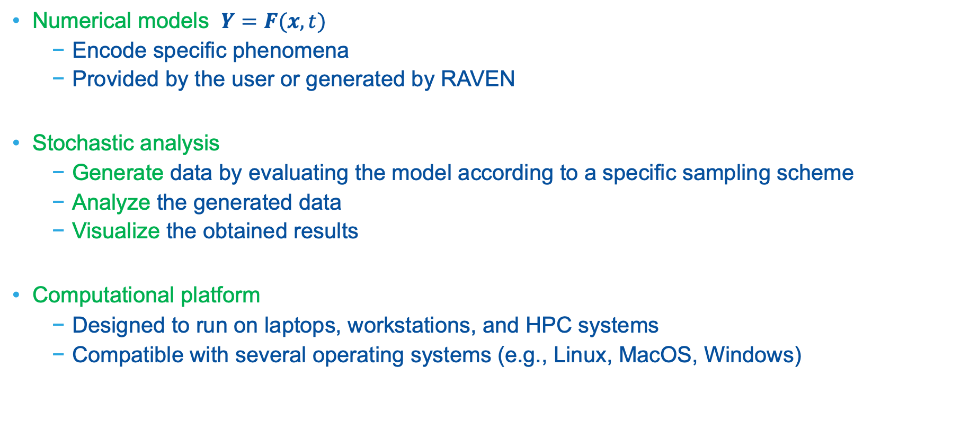
10,000-ft Overview
Numerical models $Y=F(x,t)$
Encode specific phenomena
Provided by the user or generated by RAVEN
Stochastic analysis
Generate data by evaluating the model according to a specific sampling scheme
Analyze the generated data
Visualize the obtained results
Computational platform
Designed to run on laptops, workstations, and HPC systems
Compatible with several operating systems (e.g., Linux, MacOS, Windows)

Slide 4
RAVEN Models

Slide 5
RAVEN Models
Numerical models: encode specific phenomena (e.g., physics, economic, reliability)
Code interfaces: link to external codes (e.g., RELAP, MELCOR, OpenModelica, MOOSE apps, SAPHIRE, RAVEN)
Interface with other codes can be created
Reduced-order models (ROMs): mathematical models (e.g., classifiers, regressors) initialized by a dataset
External libraries: Scikit-learn, TensorFlow (e.g., SVM, GPM, neural networks, ARMA)
Internally developed
SyntheticHistories: generation of synthetic time series
DMD: dynamic mode decomposition for time-dependent ROMs
External models: custom Python script
Fast and simple mathematical/logical models

Slide 6
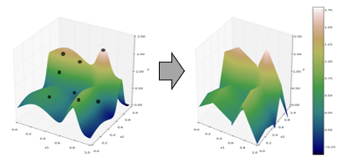
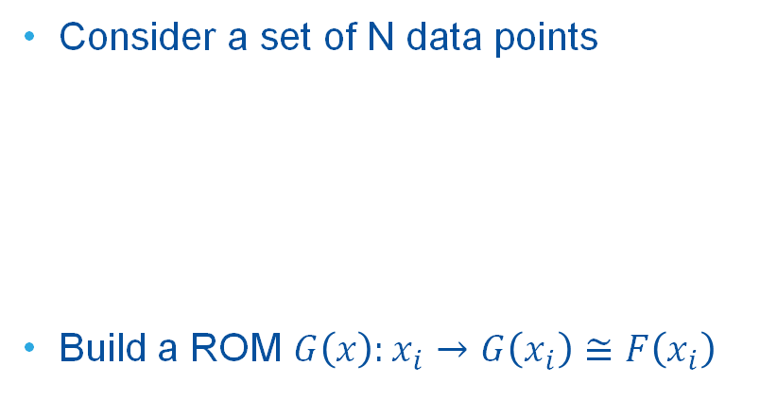
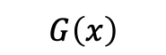
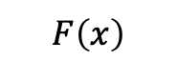
ROMs: Quick Introduction
Consider a set of N data points
Build a ROM $G\left(x\right):x_{i}→$ $G\left(x_{i}\right)≅F\left(x_{i}\right)$
Output: Simulation outcome (success or failure, max clad temperature)
Data
Inputs: Initial and boundary conditions
$$F\left(x\right)$$
$$G\left(x\right)$$

Slide 7
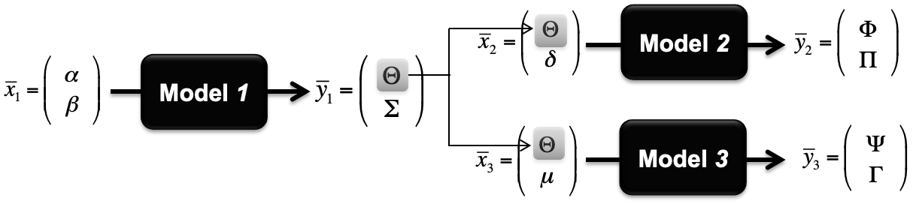
RAVEN Model Linking
Ensemble models: link models together in a linear fashion (i.e., parallel, serial)
Example: analysis of a multi-unit power plant

Slide 8
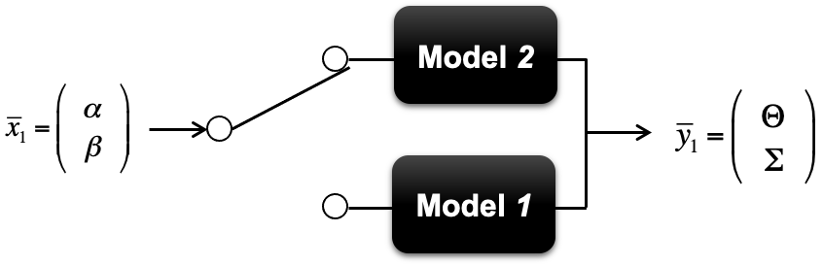
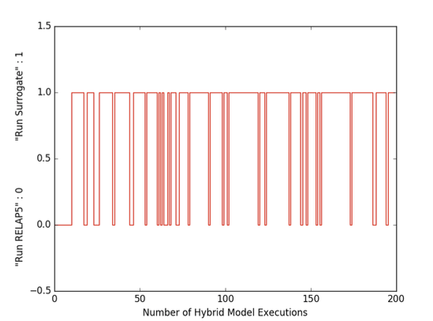
RAVEN Model Linking
Logical/hybrid models: the execution of a model is dictated by a provided decision function, e.g.:
System logic controlled
Choice between high- or low-fidelity models
Example: automatic model selection for a PWR SBO sequence, using RELAP5-3D and a SVM surrogate model
Analysis: 1000 Monte Carlo samples
200 were run using the RELAP5-3D model
Computational time reduction: 800*4 = 3200 CPU hours

Slide 9
RAVEN Data Generation Methods

Slide 10
RAVEN Probabilistic Distributions
One-Dimensional Distributions
N-Dimensional Distributions
Import from the file for custom N-dimensional distributions:
N-dimensional splines on Cartesian grids
Inverse weight interpolation
Sampling of N-dimensional distributions through unbiased inversion
PDF | Truncated | PDF | Truncated
Bernoulli | No | Poisson | No
Binomial | No | Triangular | Yes
Exponential | Yes | Uniform | Yes
Normal | Yes | Weibull | Yes
LogNormal | Yes | Gamma | Yes
Logistic | Yes | Beta | Yes
Categorical | Yes | Laplace | Yes
Geometrical | Yes | Custom | Yes

Slide 11
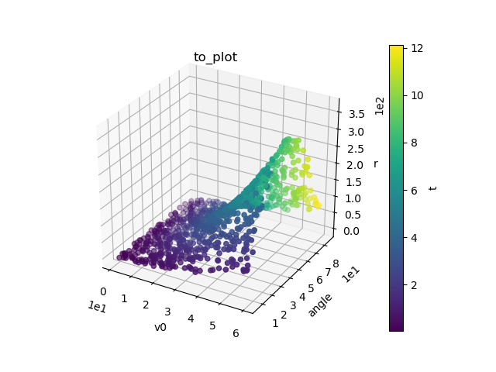
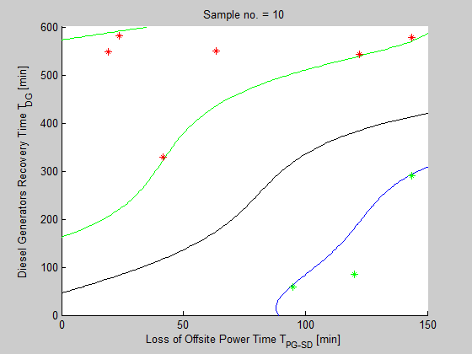
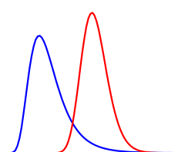
RAVEN Samplers
Generate data by evaluating model responses according to a specified sampling scheme
Sampler classes
Forward samplers
Monte-Carlo, grid, ensemble sampling, stratified, custom, etc.
Adaptive samplers
Markov Chain Monte Carlo (MCMC)
Generalized stochastic collocation polynomial chaos
Input
Output
Data
Model

Slide 12
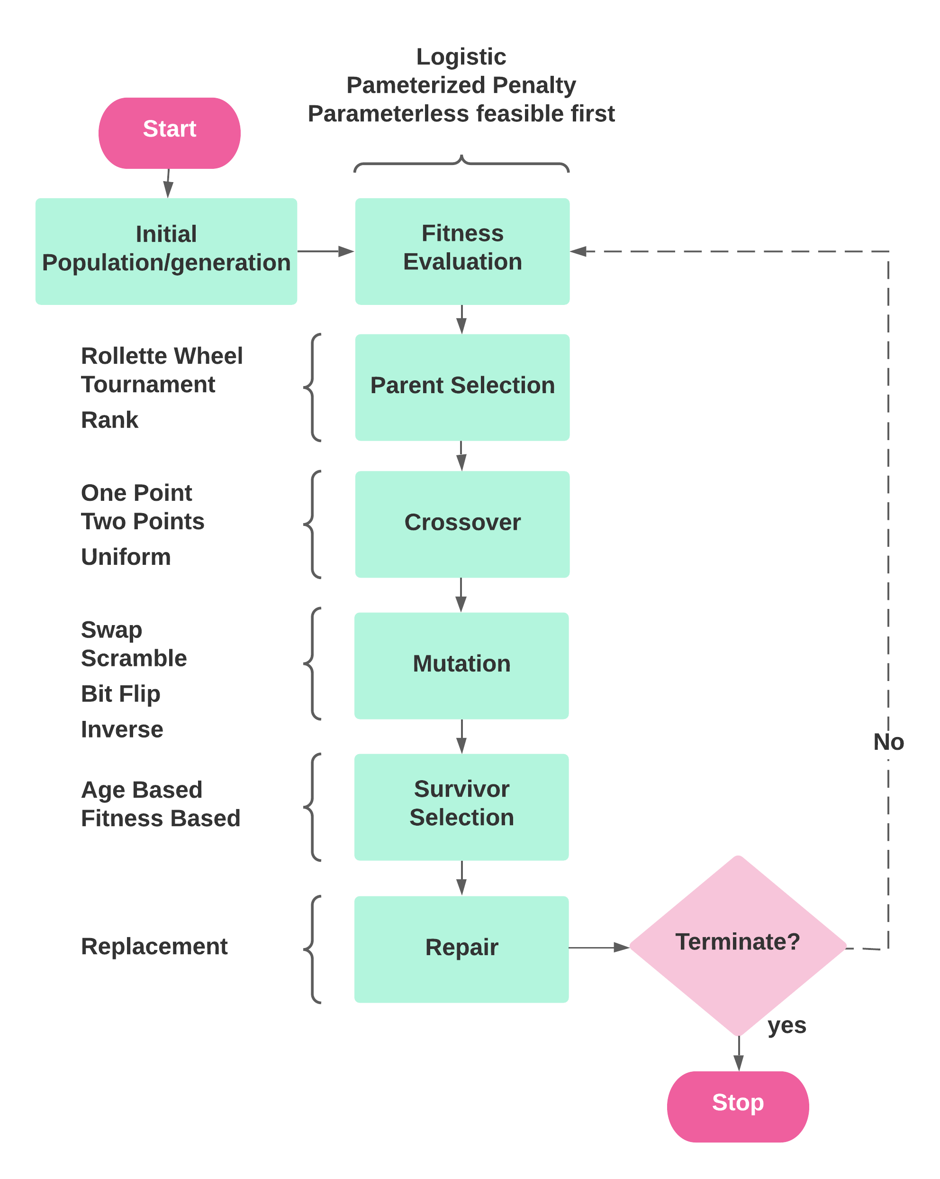
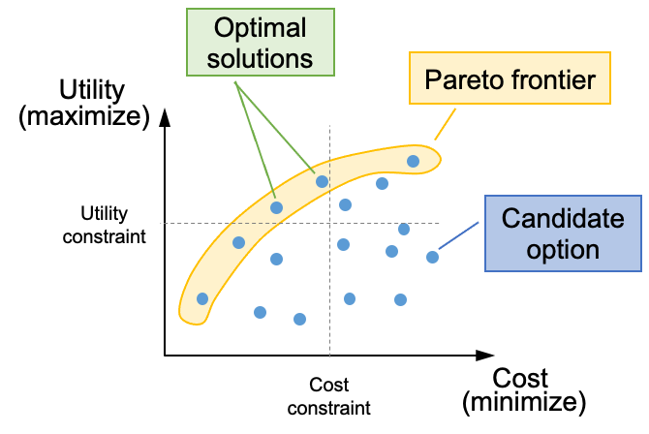
RAVEN Optimizers
Genetic algorithms
Pareto frontier analysis
Gradient descent
Simulated annealing
SPSA: simultaneous perturbation stochastic approximation

Slide 13
RAVEN Data Analysis Methods

Slide 14
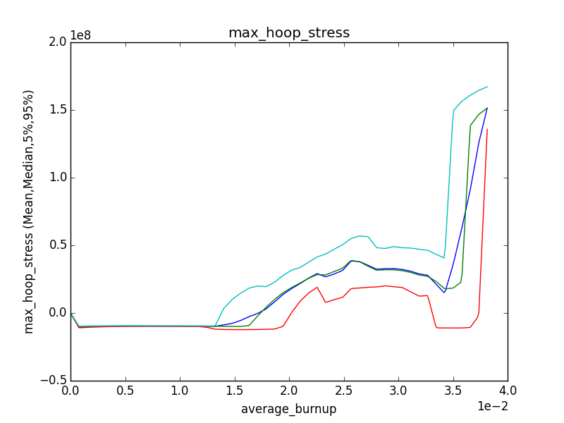
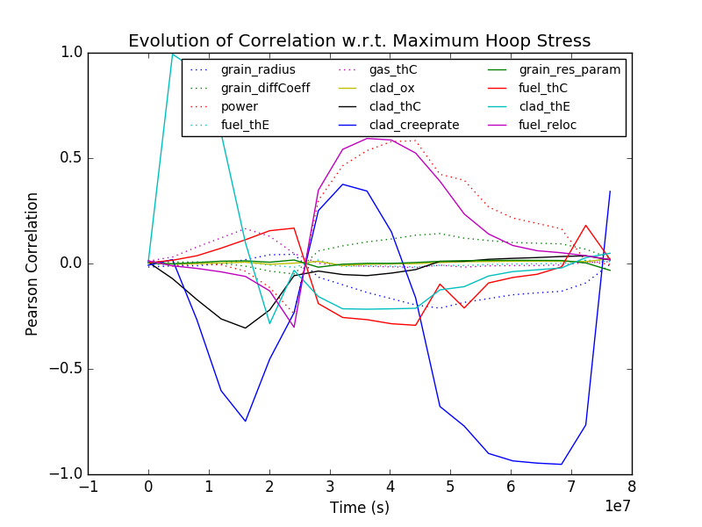
Classical Data Analysis Methods
Statistical characterization of a sampled variable
Mean
Sigma
Skewness
Kurtosis
Input/output relationship (ranking/sensitivity)
Sensitivity matrix
Covariance matrix
Pearson matrix
Spearman
95% percentile
Mean
5% percentile

Slide 15
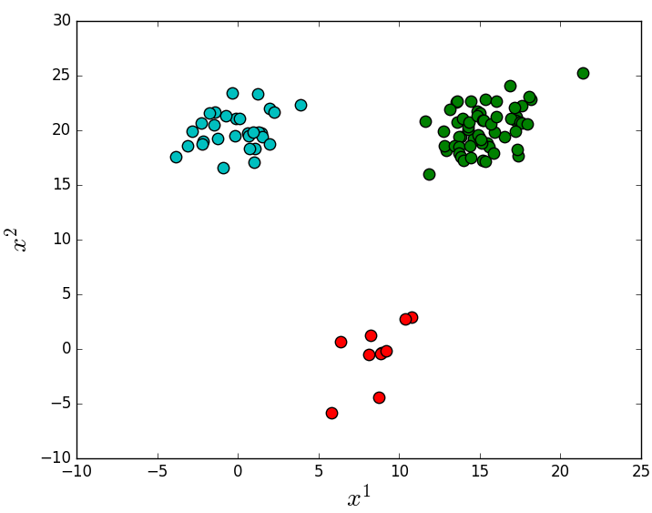
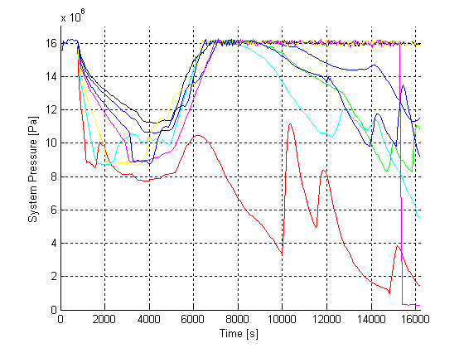
Advanced Data Mining Methods
Clustering: Partition data sets into clusters (static data, time-series)
Identify correlations between system dynamics and the timing of events
Identify outliers: “bogus” simulations whose dynamics differ from those of all other simulations (e.g., out of validity bounds for simulator parameters)

Slide 16
RAVEN Infrastructure

Slide 17
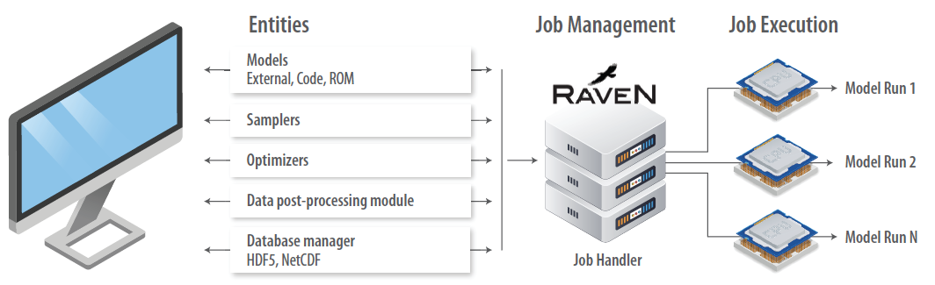
RAVEN Infrastructure

Slide 18
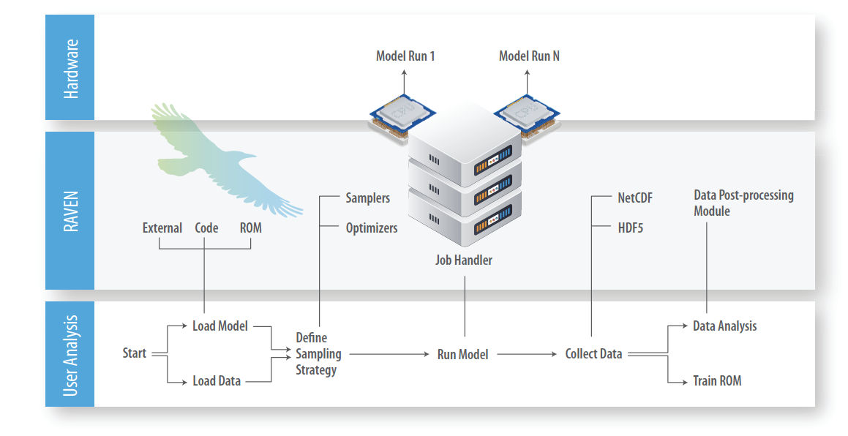
RAVEN Infrastructure

Slide 19
RAVEN Software Practices
Multiple operating systems are supported (and automatically tested)
Windows: 7, 8, 8.1, 10
Linux: Ubuntu, Fedora, CentOS, OpenSUSE
MacOS: from Sierra to Monterey
RAVEN development is conducted under a strict software quality assurance process
Multi-level peer-review process
Automatic verification (testing) (~750 regression tests)
Clone and install RAVEN on your machine
RAVEN Git repository: https://github.com/idaholab/raven/wiki
Installation page: https://github.com/idaholab/raven/wiki/installationMain
Learn RAVEN through available documentation
User guide: a brief guide on how to use RAVEN
Workshop materials: slide sets and examples of specific RAVEN test cases
User manual: detailed guide regarding all RAVEN entities
Contact us for issues, comments, or request assistance: inl-raven-users@googlegroups.com

Slide 20
RAVEN Applications

Slide 21
RAVEN Plugins
RAVEN
RAVEN:
Main computational driver
Uncertainty quantification and optimization capabilities
HERON
Techno-economic analysis for IES
SR²ML
System reliability analysis
Plugins:
Libraries of models designed for specific use cases
Easy interface to RAVEN
TEAL
Economic models
Plugin repositories:
Source code
Documentation (e.g., user manual)
Regression tests
LOGOS
Plant resource optimization models
FARM
Feasible Actuator Range Modifier

Slide 22
HERON: Holistic Economic Resource Optimization Network
Stochastic techno-economic analysis for grid energy systems
Stochastic: directly incorporates uncertainty in loads, markets, weather
Technical: includes native handling of many resources, components
Electricity, hydrogen, wind, solar, water
Generators, suppliers, markets
Min/max production levels, ramp rates
Economic
Maximize NPV or minimize system costs
Optimize based on risk-weighted statistical stochastic behavior
wind
demand
solar
markets
Synthetic time histories
Optimal dispatch
Economic Analysis
Repeat for Many Histories
Mean
Economic
Metrics
New
Grid
System
Component Sizing,
Statistics

Slide 23
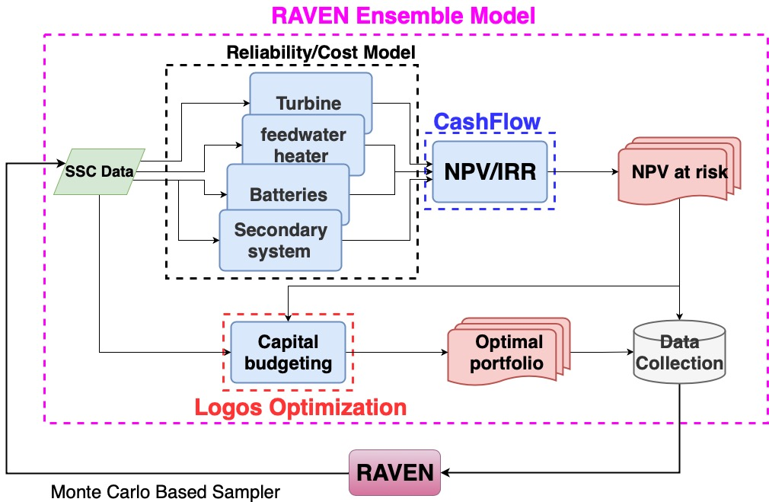
LOGOS
Goal: provide plant resource optimization tools
Modeling capabilities (for model-based optimization)
Several variants of the knapsack model
Job schedule models
Simulation-based approach
Method capabilities (for data-based optimization)
Deterministic budgeting
Stochastic budgeting
Risk-based budgeting
Distributionally robust budgeting
Job scheduling optimization
Use
Standalone tools (for data-based optimization)
Interface with RAVEN as an external model (for model-based optimization)
SR2ML:

Slide 24
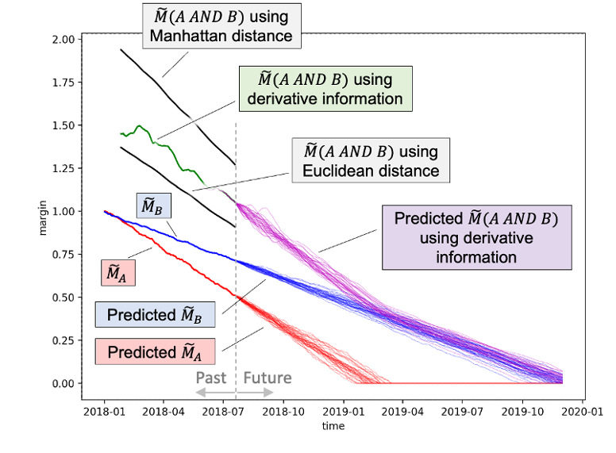
SR²ML
Tools and methods to perform safety risk and reliability analyses
Equipment reliability data analysis (underway)
Reliability models that integrate ageing and surveillance
Margin-based reliability analysis
Simulation-based risk modeling (dynamic PRA)

Slide 25
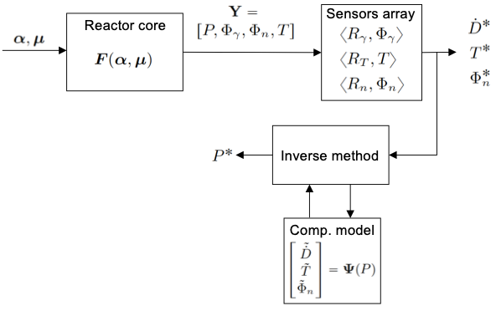
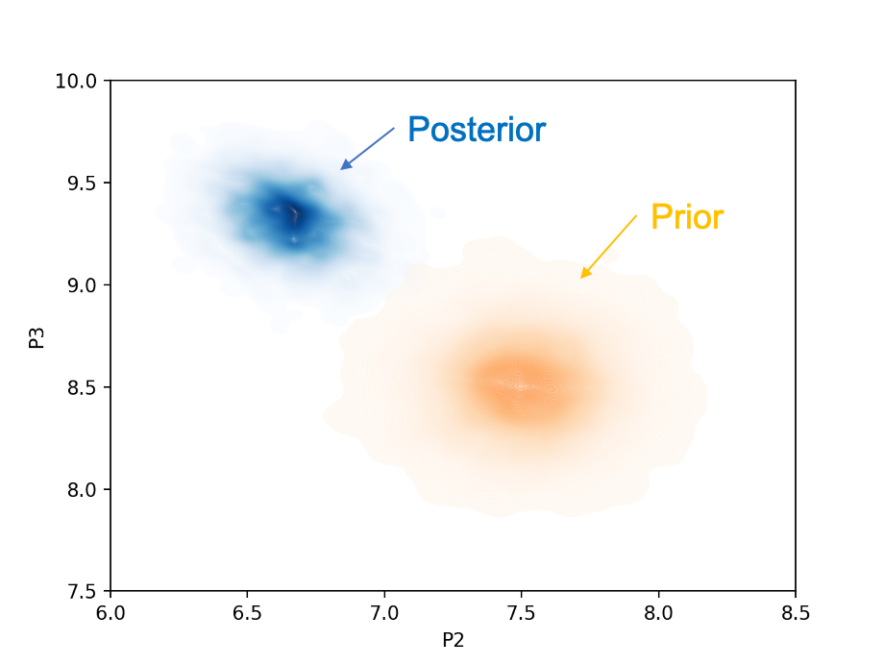
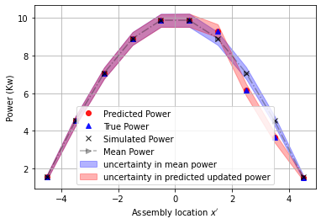
Integration of Measured and Simulation Data
Data analytics methods for integrating measured data and simulation models to reconstruct core power profiles (i.e., solve the inverse problem)
Machine-learning approach
Gradient-based optimization method
Inverse Bayesian approach
Sensor data preprocessing

Slide 26
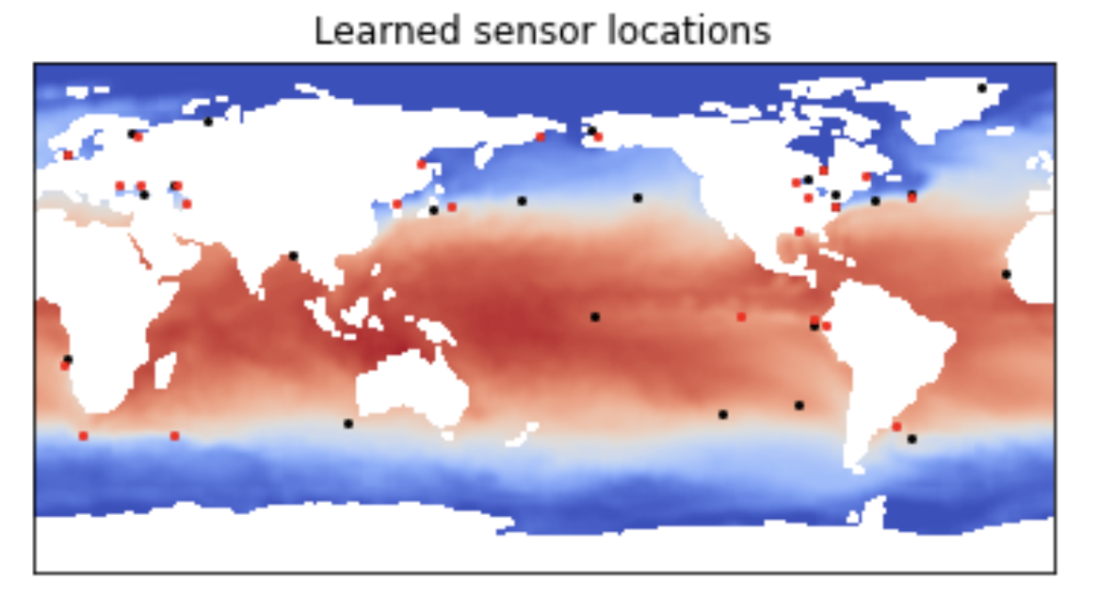


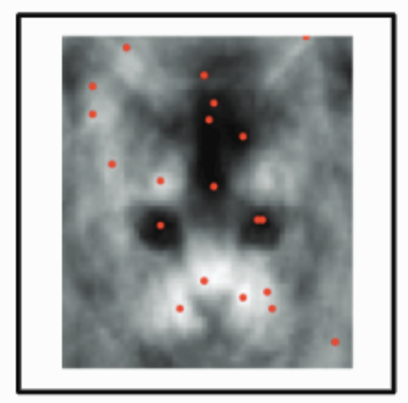
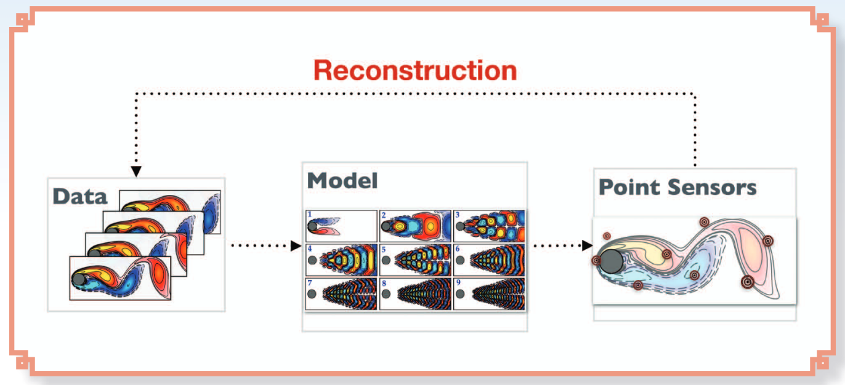
Sparse Sensing/Learning
Risk//Reliability Analysis
Control
(Un)supervised Learning
Sparse Learning
Cyber Resilience and DSP/TSA
Sparse Learning
SPSL
Model/data assimilation/adjustment
Reinforcement Learning
SSPOC, SSPOR
Economical Modeling
Validation
Anomaly detection
Optimization
Manohar, Krithika, et al. "Data-driven sparse sensor placement for reconstruction: Demonstrating the benefits of exploiting known patterns." IEEE Control Systems Magazine 38.3 (2018): 63-86.
Brunton, Bingni W., et al. "Sparse sensor placement optimization for classification." SIAM Journal on Applied Mathematics 76.5 (2016): 2099-2122.
System Optimization

Slide 27
Future Directions for RAVEN

Slide 28
Reinforcement Learning
Potential DRL-enhanced control loop for IES

Slide 29
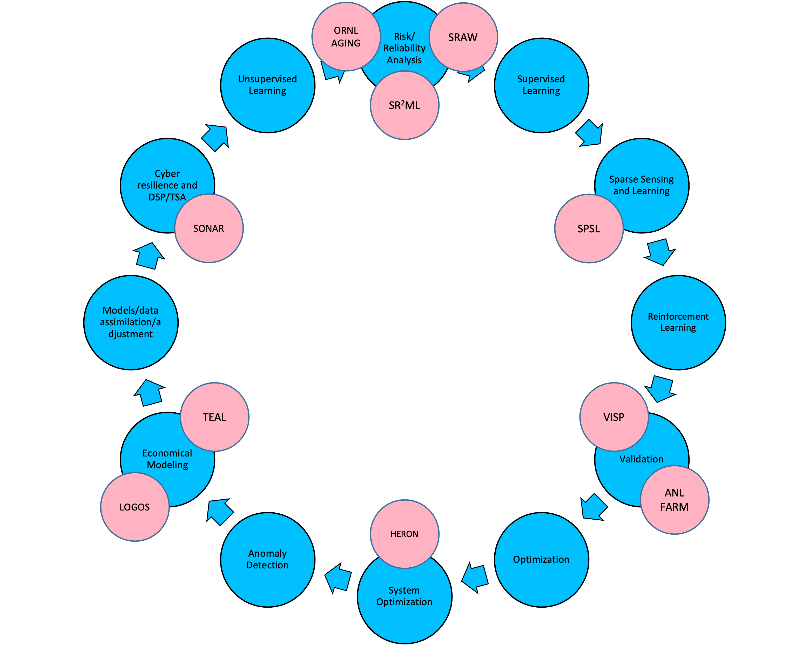
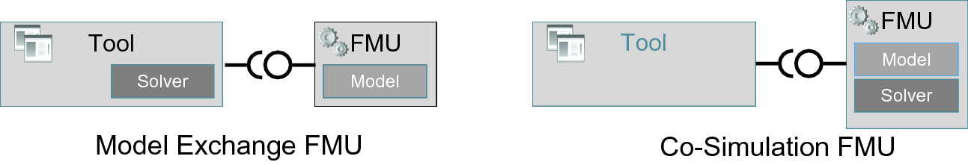



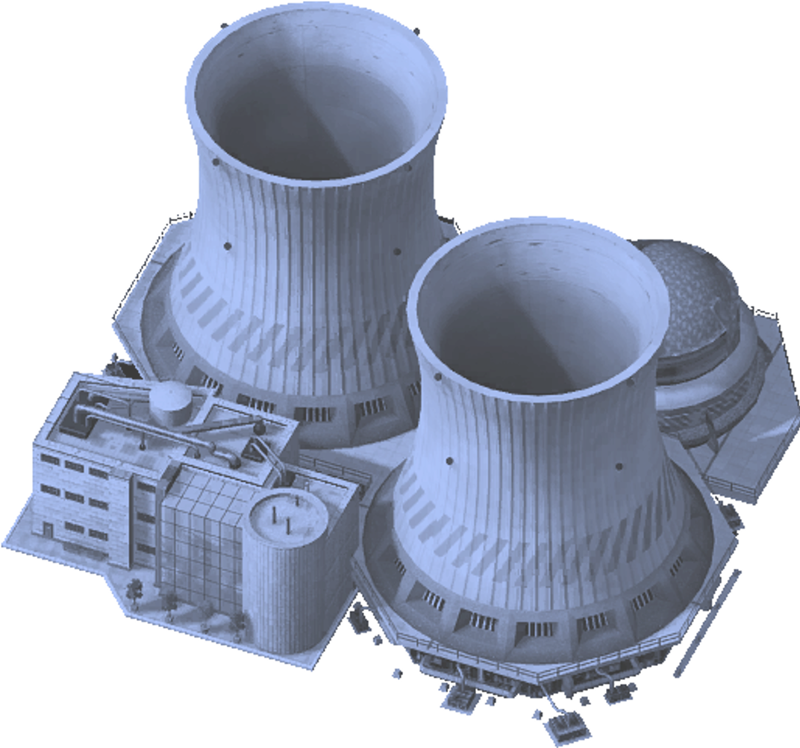


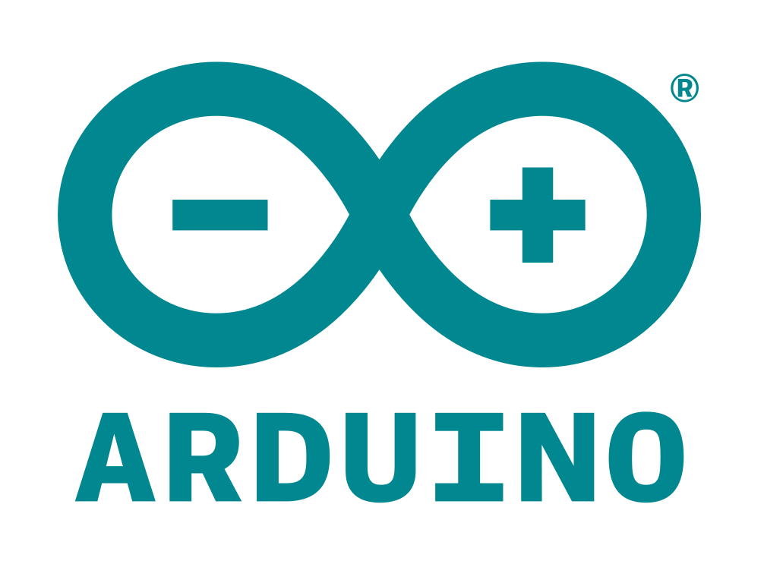
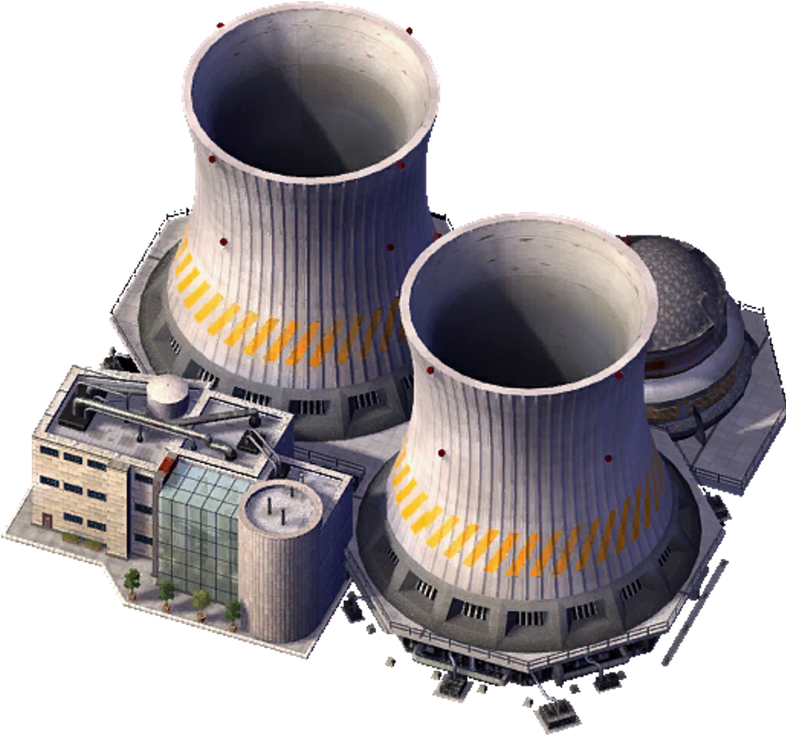



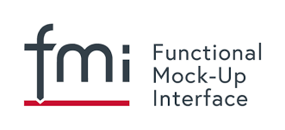
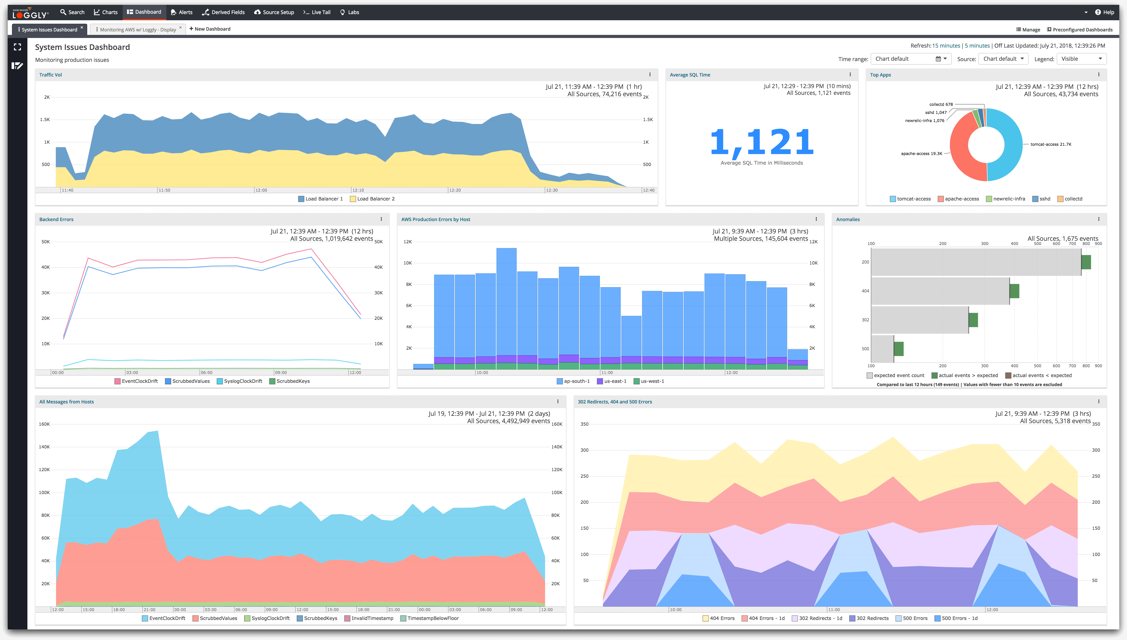
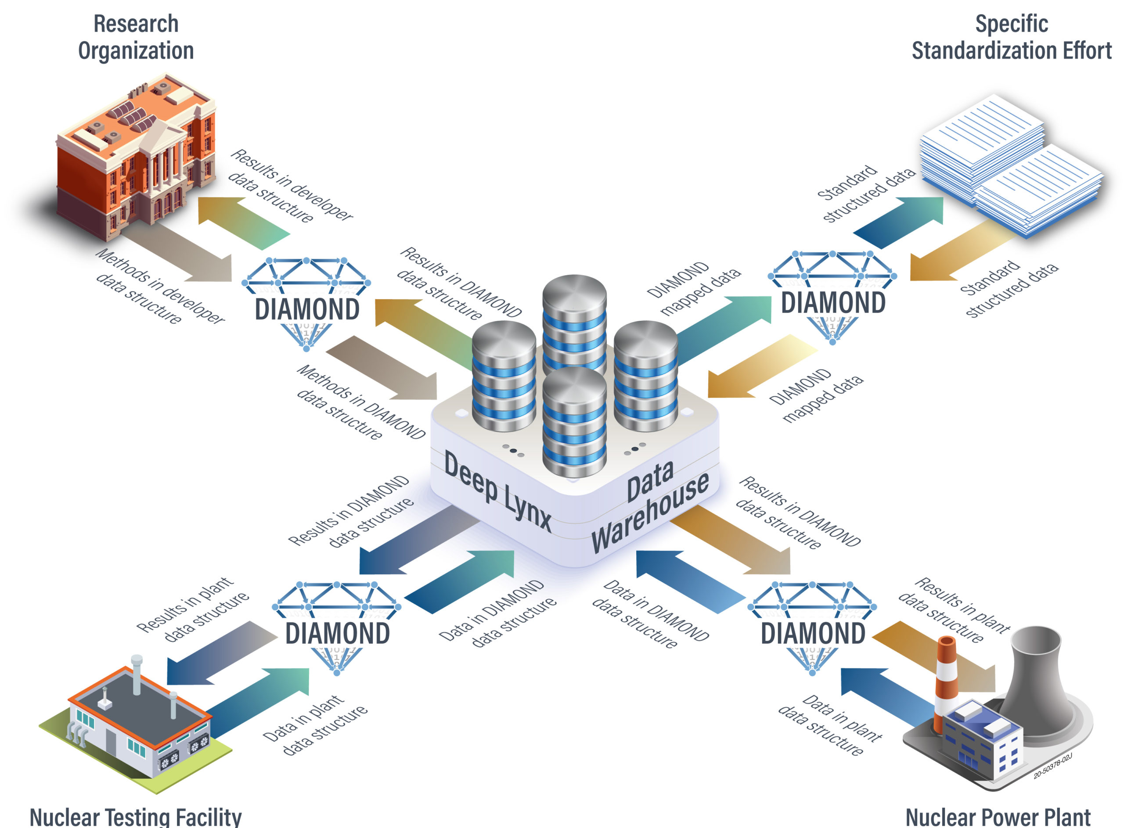
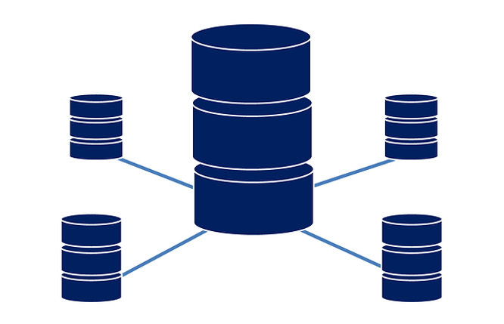

Digital Twins
Capability/service space
Analytics(ML/AI)
Actuators
I&C
Physical Space
Digital Space
Data Space

Slide 30
Backup slides

Slide 31
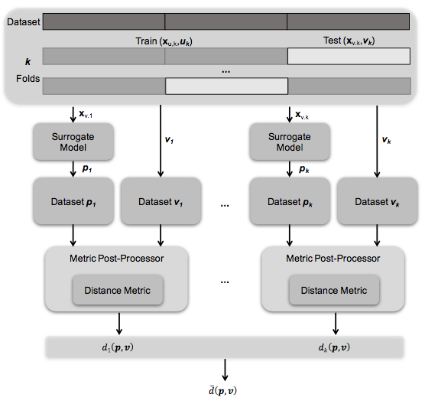
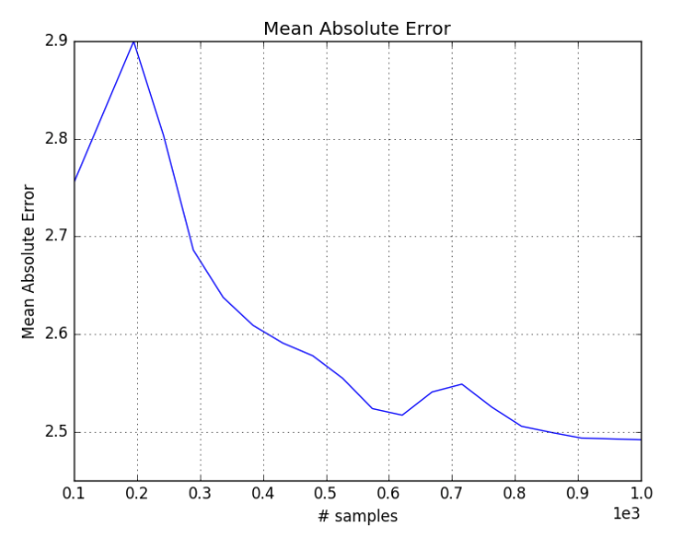
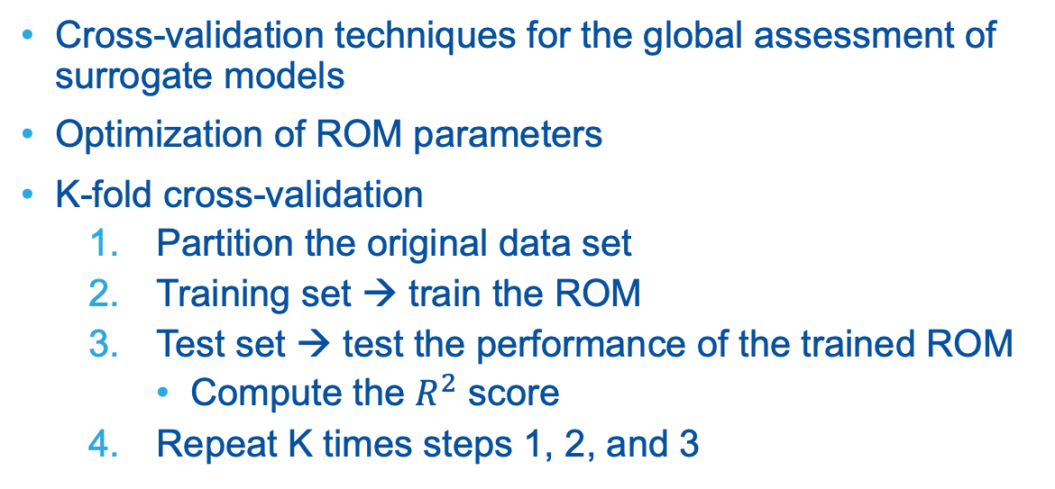
ROM Cross-Validation
Cross-validation techniques for the global assessment of surrogate models
Optimization of ROM parameters
K-fold cross-validation
Partition the original data set
Training set → train the ROM
Test set → test the performance of the trained ROM
Compute the $R^{2}$ score
Repeat K times steps 1, 2, and 3
Mean absolute error score (cross-validation) as a function of number of samples

Slide 32
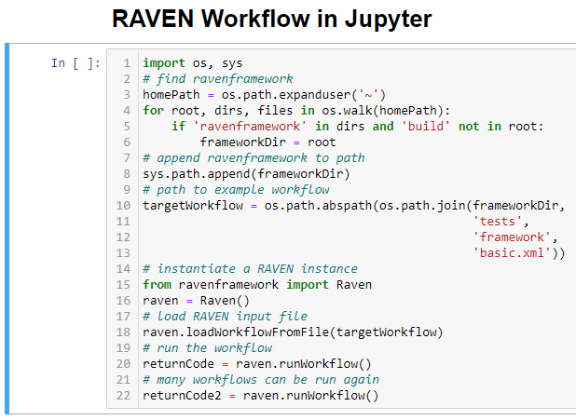
Running RAVEN from Jupyter
Find ravenframework directory
Append to path
Provide path to input file
Instantiate PythonRaven
Load input file
Run workflow
Rerun workflow

Slide 33
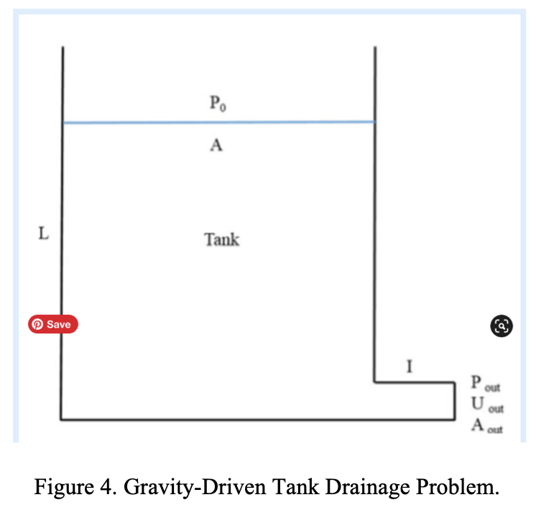
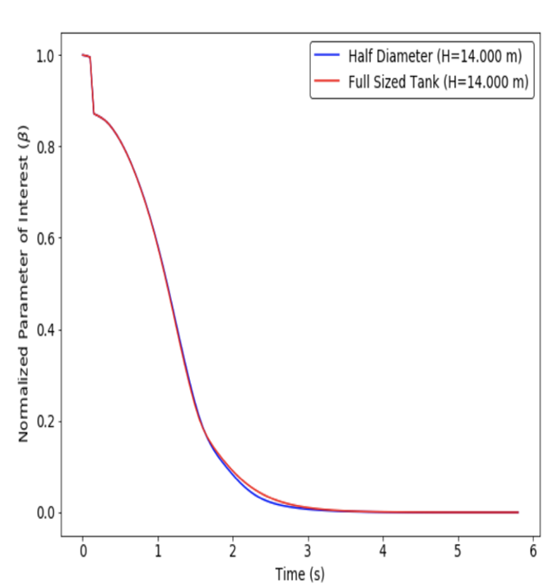
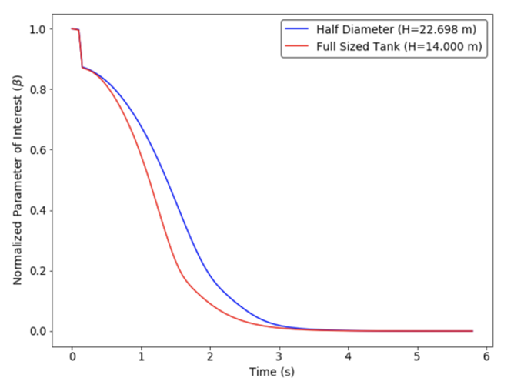
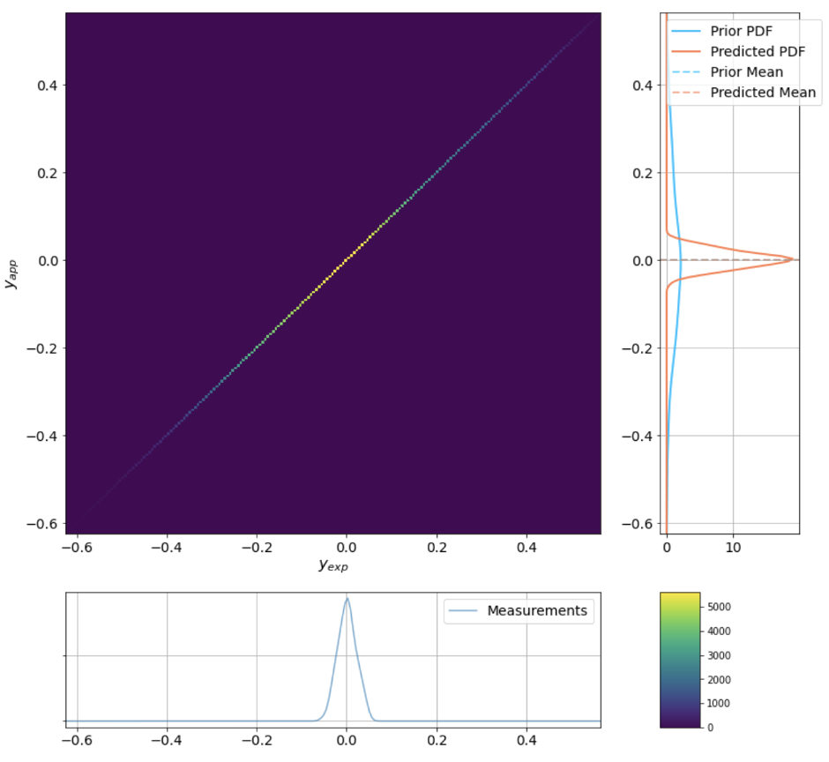
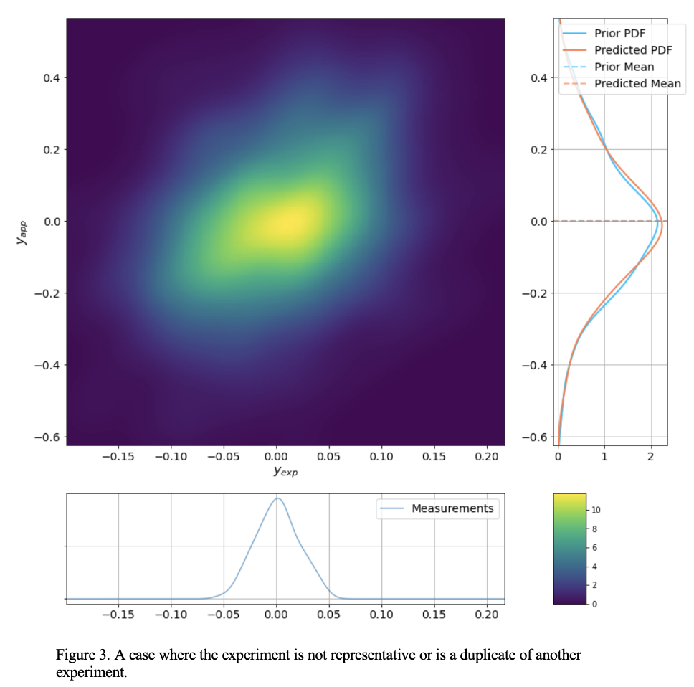
RAVEN for Code Validation
Dynamic system scaling (DSS)
Validation metrics: several methods for comparing two populations (experiment and simulation data)
Physics-guided convergence mapping (PCM)

